Slide 1
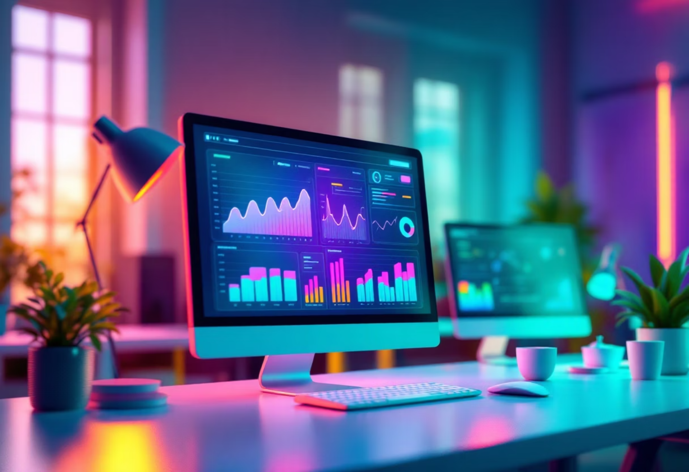
Meta Ad Performance Analysis

Slide 2
DASHBOARD INSIGHTS
KPI Metrics
216K
25.4K
1.3K
2.6K
Impressions
Clicks
Shares
Comments
Total times the ads were shown. Good reach.
Number of people who clicked on the ads.
Indicators of organic engagement (beyond paid reach).
Indicators of organic engagement (beyond paid reach).

Slide 3
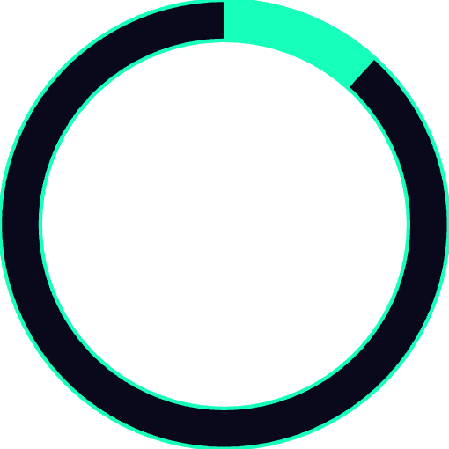
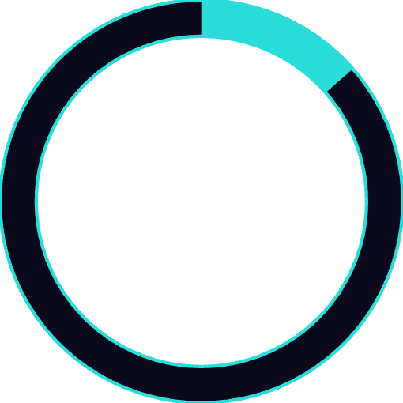
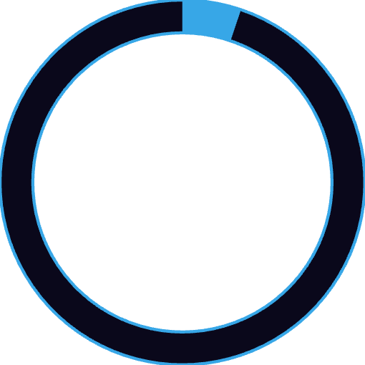

1.3K
29K
2.5M
50.7K
Purchases (Conversions)
Engagements
Total Budget
Avg Budget per Campaign
Real customer acquisitions from ads.
Sum of clicks, likes, shares, comments.
Total ad spends.
Suggests multiple campaigns were run.
11.76%
13.56%
CTR (Click-Through Rate)
Engagement Rate
Strong performance (above industry average ~1-2%). Ads are very attractive.
Very healthy; content resonates with the audience.
5.21%
0.61%
Conversion Rate
Purchase Rate
Out of all clicks, 5.21% converted into purchases. Good but could improve with landing page optimization.
Out of impressions, only 0.61% resulted in purchases. Low conversion funnel efficiency (room to optimize).
Insight: Ads are performing strongly in visibility and engagement, but actual purchase efficiency is weak: need to optimize targeting/landing pages.

Slide 4
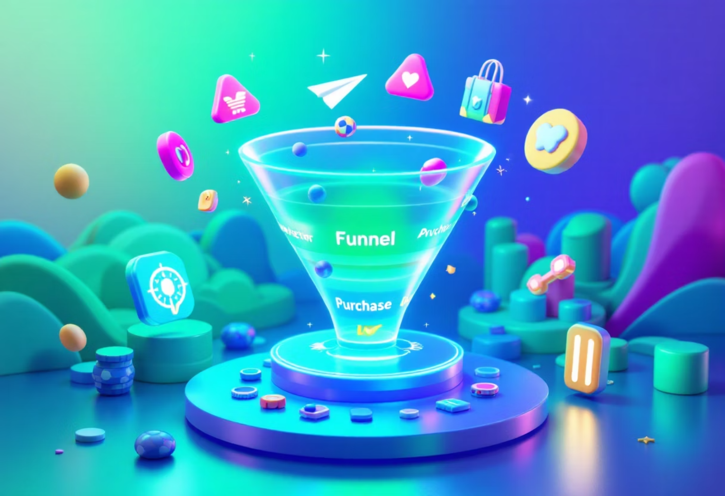
Performance Analysis
Top of Funnel: Strong
Bottom of Funnel: Weak
High CTR (11.76%) and Engagement Rate (13.56%) → clearly indicate that the ad creatives, messaging, and targeting at the top of the funnel are very effective.
Low Purchase Rate (0.61%) and only 1.3K conversions out of 216K impressions → shows a sharp drop-off in the lower funnel.
This is a classic case of "awareness and interest" being strong but "action (purchase)" being weak.
People are interested enough to click, like, share, or comment.

Slide 5
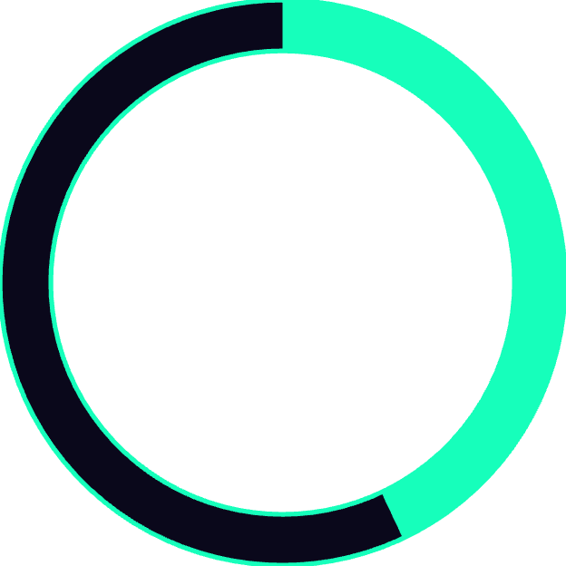
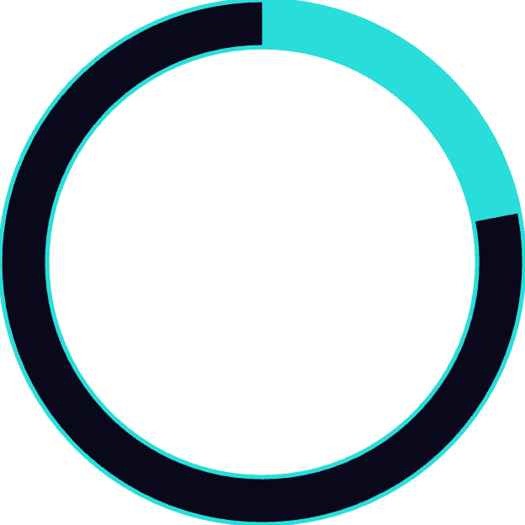
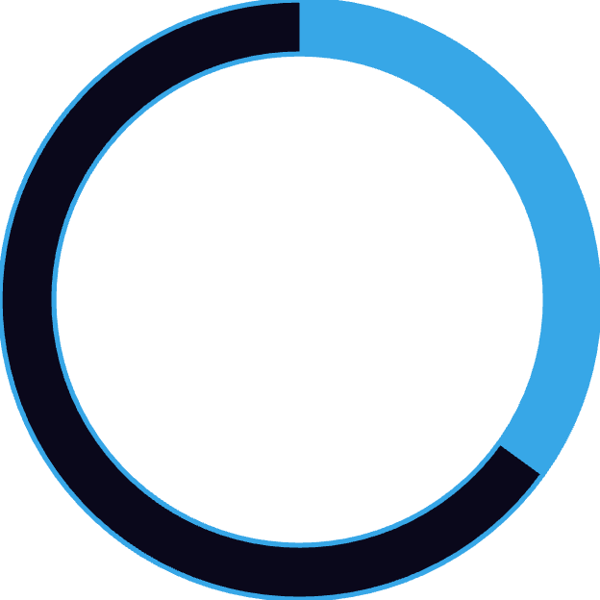

Engagement Breakdown
By Gender (Donut Chart)
43%
22%
35%
Female
Male
Other/Not Specified
13K engagements
6K engagements
10K engagements
Females engage more than males; campaigns could be tailored toward female audiences.
By Target Age (Bar Chart)
Peak engagement: 20–30 age group (especially early 20s).
Drops significantly after 35+.
Primary audience = Young adults.
Insight: Target ads towards females aged 18–30 for better ROI.

Slide 6
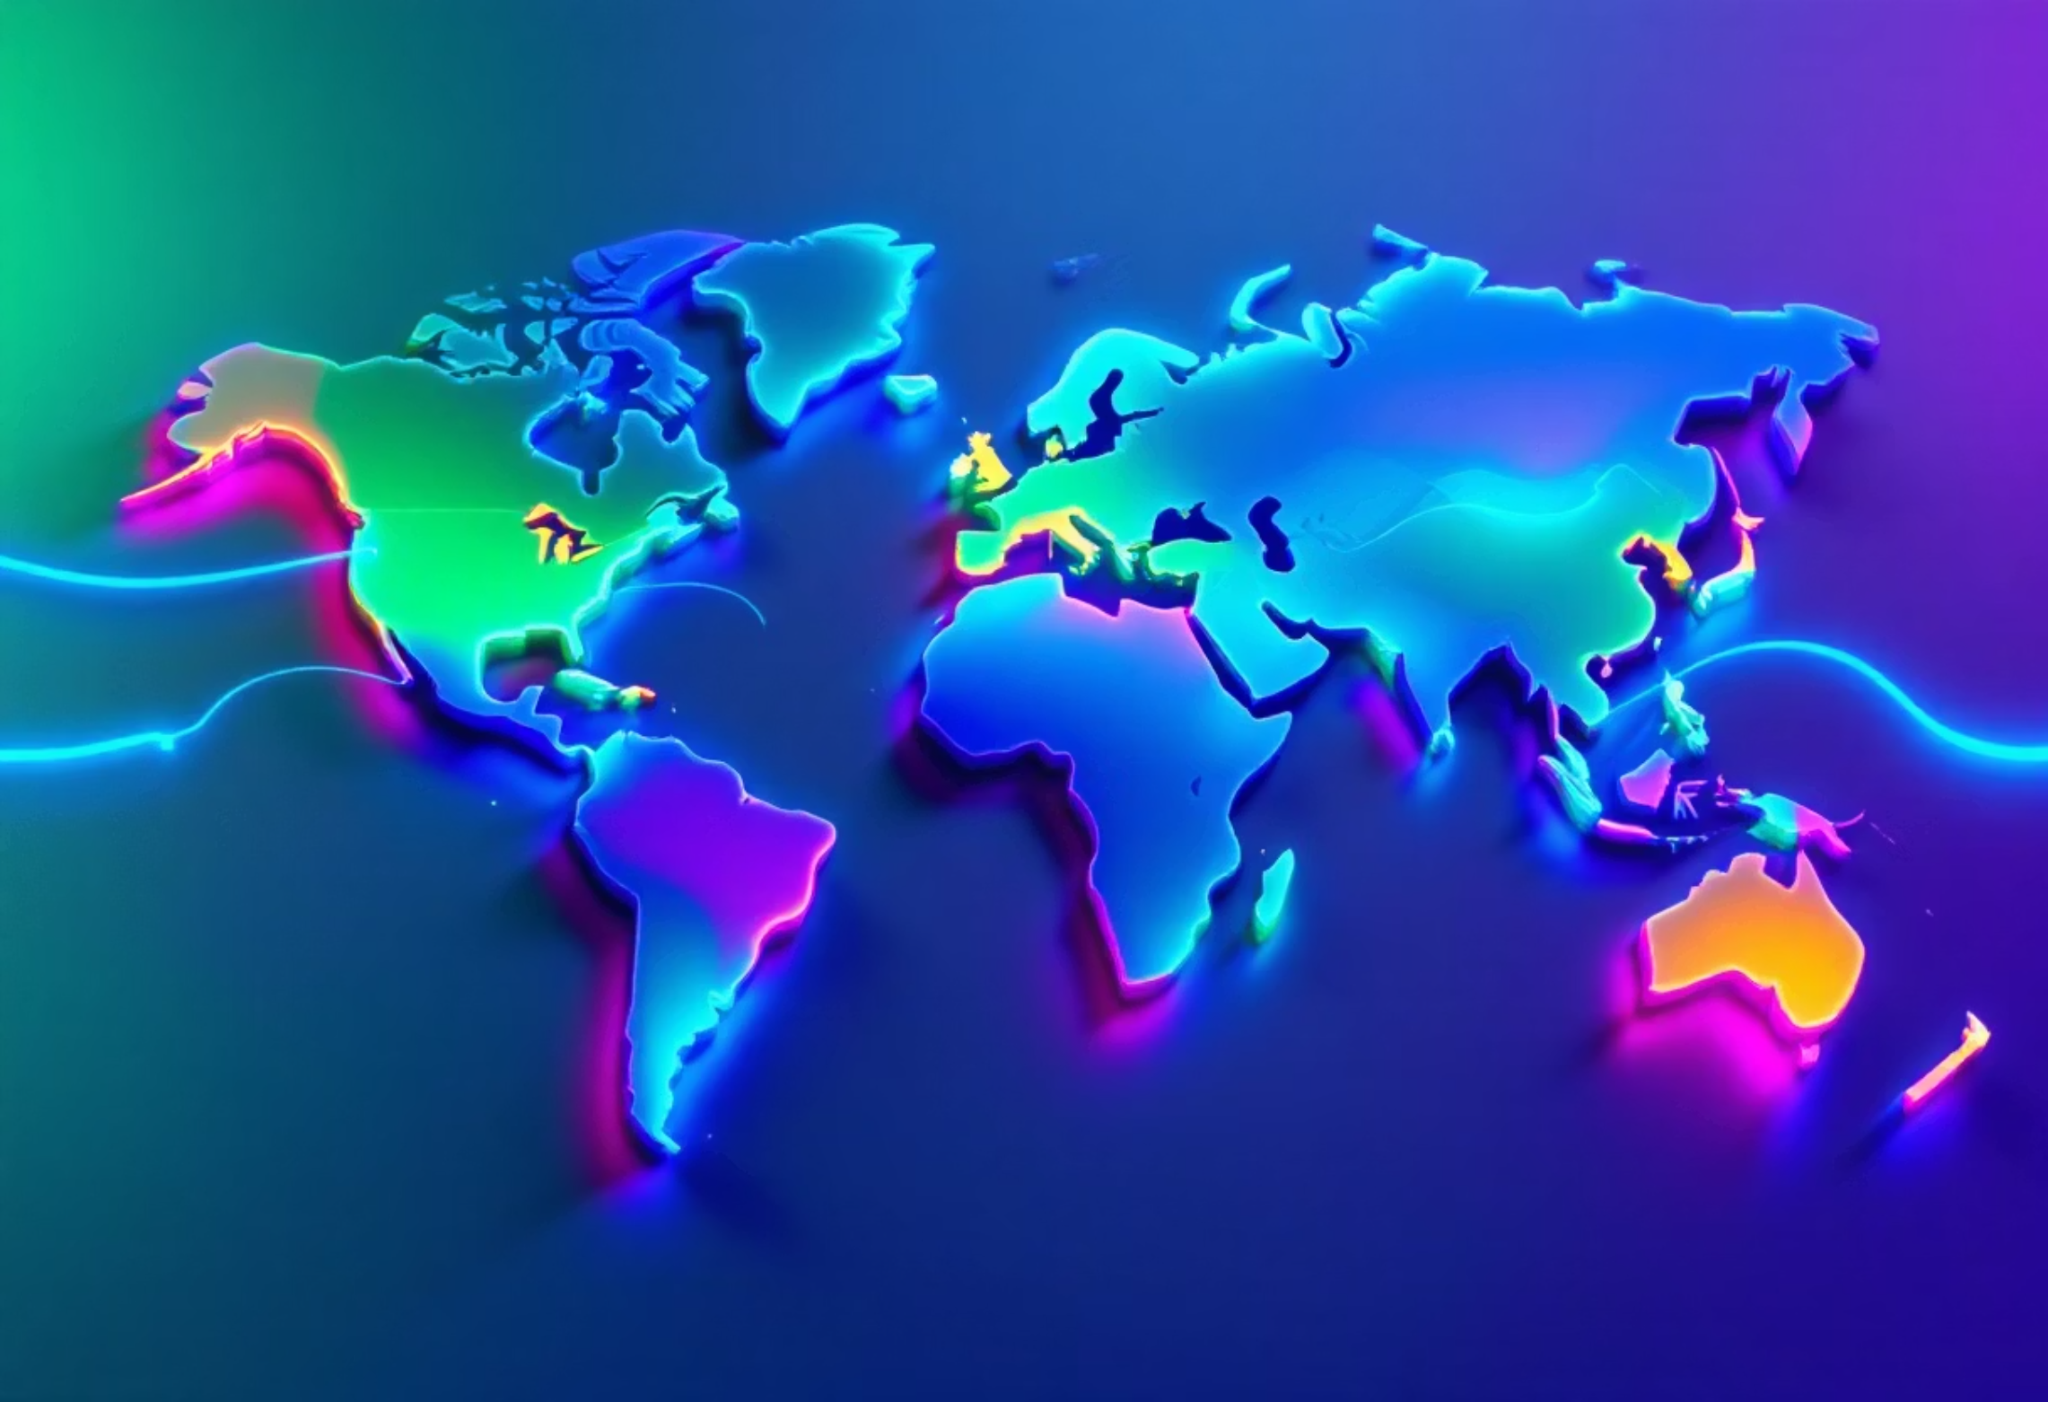
Geographic Distribution
Top Engaged Countries
US, India, Brazil, Germany, UK are major contributors.
Insight: Focus campaigns in India & US (high potential, high engagement), and premium campaigns in Germany/UK (better conversion potential due to higher purchasing power).

Slide 7

Time-Based Trends
Weekly Engagement Trend (Stacked Bar)
Fairly consistent across weeks, with no sharp drop.
Steady engagement shows ads maintain attention.
Hourly Engagement Trend (Line Chart)
Peaks around late afternoon & evening (~15–20 hours).
Lowest engagement early morning (~0–5 hours).
Insight: Schedule ad delivery during afternoons & evenings for maximum impact.
Calendar View
Engagements are mapped to days in June.
Certain dates (like 19th–21st, 25th–27th) show higher highlights. Campaign activity peaks on specific days, possibly due to launches/promotions.
Insight: Weekly promotions/events significantly drive engagement.

Slide 8

Analysis by Ad Type
Ad Type
Impressions
Clicks
CTR
Purchase Rate
Conversion Rate
Engagement Rate
Carousel
48K
6K
11.7%
0.59%
5.1%
13.4%
Image
51K
6K
11.7%
0.57%
4.9%
13.5%
Stories
72K
8K
11.8%
0.65%
5.2%
13.6%
Video
46K
5K
11.9%
0.62%
5.2%
13.7%
Video ads
Stories ads
Images/Carousel
Have the highest CTR, CR, ER (best-performing).
Also perform strongly with higher impressions.
Have decent performance but slightly lower conversions.
Insight: Focus budget more on Video & Story ads for better ROI.

Slide 9
Final Insights & Recommendations
01
02
Strong awareness & engagement
Target audience
(high CTR & ER), but low purchase funnel efficiency: need better conversion strategy.
Females, 18–30, especially in India & Brazil.
03
04
Best ad formats
Timing
Video > Stories > Carousel/Image.
Schedule ads in the afternoon & evening slots.
05
06
Budget Optimization
Action
Shift more spend to high-performing geographies and ad formats.
Improve landing pages, offers, retargeting campaigns to lift purchase rate.

Slide 10

Next Steps
Optimize the conversion funnel to transform strong engagement into actual purchases

